Slide 1
IDS 702 Team Project
Gray Team (Nick Carroll, Jiaxin Ying, Emmanuel Ruhamyankaka, Song Young Oh)
11/29/2022

Slide 2
Table of Contents
Background
Methods
Results
Conclusion

Slide 3

Motivation
I. Background
Almost all kinds of sports are part of data analytics in recent years.
Tennis datasets especially have an extensive collection of information.
Both continuous and categorical variables can be explored in tennis analytics.
Gray Team (Nick Carroll, Jiaxin Ying, Emmanuel Ruhamyankaka, Song Young Oh)

Slide 4
Data Source
I. Background
Dataset has been uploaded by Jeff Sackmann, a manager of Tennis Abstract.
Specifically, the data of men’s ATP tour-level matches is analyzed for 2021.
The data contains a sample size of 2,733 tennis matches and includes total 49 variables.
Date of the match
Each match’s
attributes
Match-specific identifier
Tournament level
2021
ATP tennis dataset
Surface types
Winner’s attributes
Results
of the match
Loser’s attributes
Winner’s performance
Loser’s performance
Winner/loser’s ATP ranking
Gray Team (Nick Carroll, Jiaxin Ying, Emmanuel Ruhamyankaka, Song Young Oh)

Slide 5





Research Questions
I. Background
Variables
Final Research Questions
tournament
name
height
surface
type
handed-ness
Can a tennis player’s rank be predicted by his attributes, specifically: height, age, nationality, and handedness?
Research
Question
1
age
match
length
nationality
winner’s
serve points
. . .
. . .
. . .
. . .
tournament
type
tournament name
tournament
size
match
length
Which factors have the greatest impact on the likelihood of an upset*?
(*upset: when the winner held a rank of at least 10 ranks lower than the loser)
Research
Question
2
winner’s
age
tournament
ID
winner’s
height
surface
type
. . .
. . .
. . .
. . .
Gray Team (Nick Carroll, Jiaxin Ying, Emmanuel Ruhamyankaka, Song Young Oh)

Slide 6


Model Selection
II. Methods
Rationale
Research 1
A multiple linear regression model will be used for the first research question.
The outcome of a player’s rank is predicted based on his multiple attributes.
This analysis seeks to predict ‘average’ rank over the course of the season.
Can a tennis player’s rank be predicted by his attributes, specifically: height, age, nationality, and handedness?
Research 2
A multiple logistic regression model will be used for the second question.
The probability of an upset occurring is evaluated based on multiple predictors.
An upset is defined as the winner’s rank being at least 10 lower than the loser’s.
Which factors have the greatest impact on the likelihood of
an upset?
Gray Team (Nick Carroll, Jiaxin Ying, Emmanuel Ruhamyankaka, Song Young Oh)

Slide 7
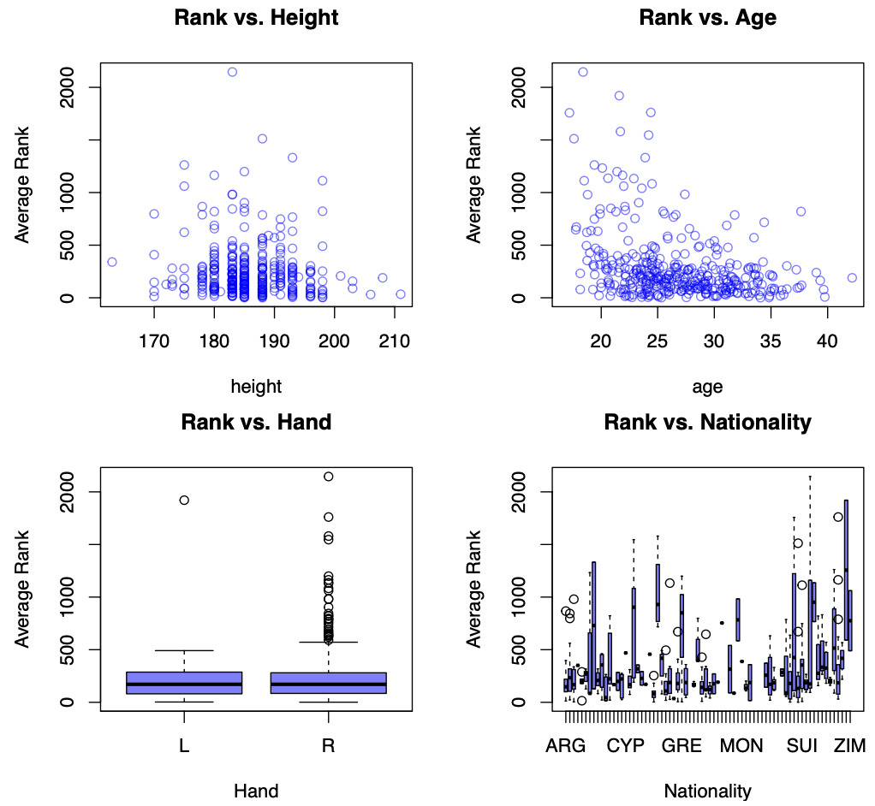
Question 1: Can a tennis player’s rank predicted by his attributes?
III. Results
Figure 1: EDA plots for Question 1
Gray Team (Nick Carroll, Jiaxin Ying, Emmanuel Ruhamyankaka, Song Young Oh)

Slide 8
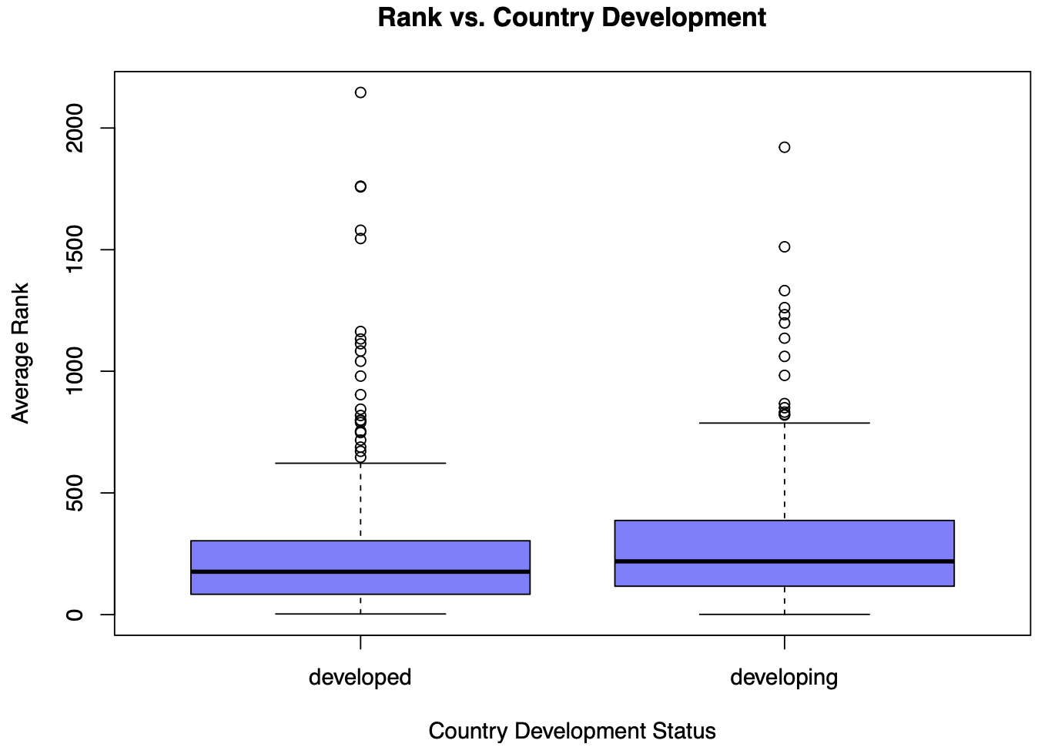
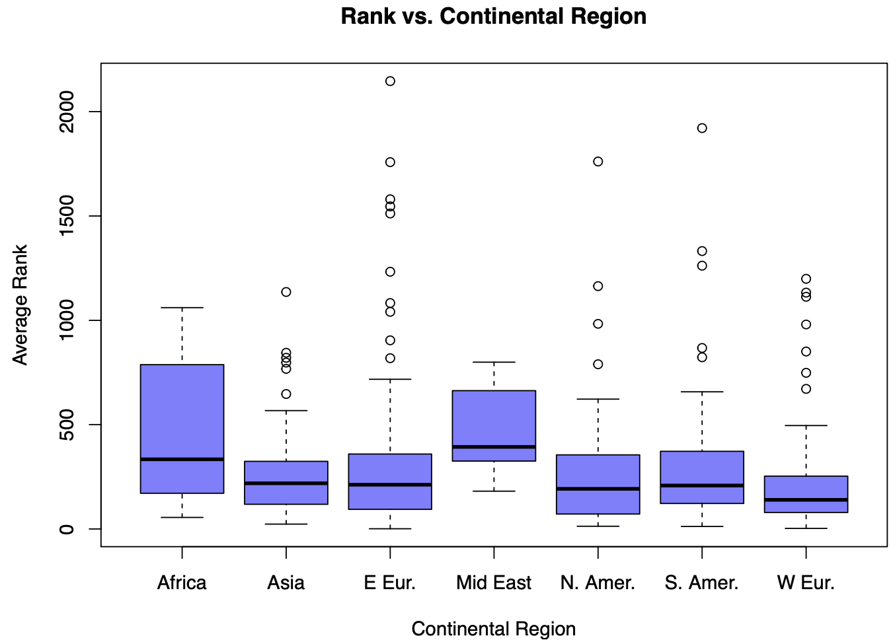
Question 1: Can a tennis player’s rank predicted by his attributes?
III. Results
Figure 2: More EDA plots for Question 1 (Rank vs. Nationality)
Gray Team (Nick Carroll, Jiaxin Ying, Emmanuel Ruhamyankaka, Song Young Oh)

Slide 9
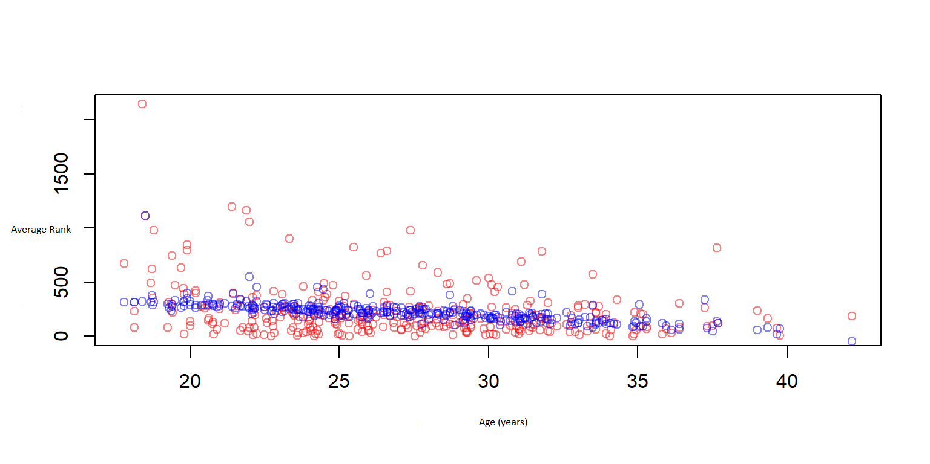
Question 1: Can a tennis player’s rank predicted by his attributes?
III. Results
Table 1: Linear Regression Model Results
Term | Estimate | S.E. | Statistic | P-value
Height | -3.8556 | 1.9081 | -2.0207 | 0.0442
Age | -11.3301 | 2.5613 | -4.4237 | 0.0000
Hand: Right | ------- | ------- | ------- | -------
Hand: Left | -37.9741 | 34.7338 | -1.0933 | 0.2751
Region: North America | ------- | ------- | ------- | -------
Region: Africa | 211.1458 | 85.2622 | 2.4764 | 0.0138
Region: Asia | -3.7804 | 58.0921 | -0.0651 | 0.9482
Region: Australia | 16.7798 | 58.0895 | 0.2889 | 0.7729
Region: Europe | -28.9559 | 38.3149 | -0.7557 | 0.4504
Region: Middle East | 139.1449 | 115.1752 | 1.2081 | 0.2279
Region: South America | -3.2483 | 49.5387 | -0.0656 | 0.9478
Significant Predictors: 1) Height,
2) Age, 3) African Nationality
R-Squared: less than 15%
Figure 3: Age vs. Rank (Prediction vs. Actual)
Gray Team (Nick Carroll, Jiaxin Ying, Emmanuel Ruhamyankaka, Song Young Oh)

Slide 10
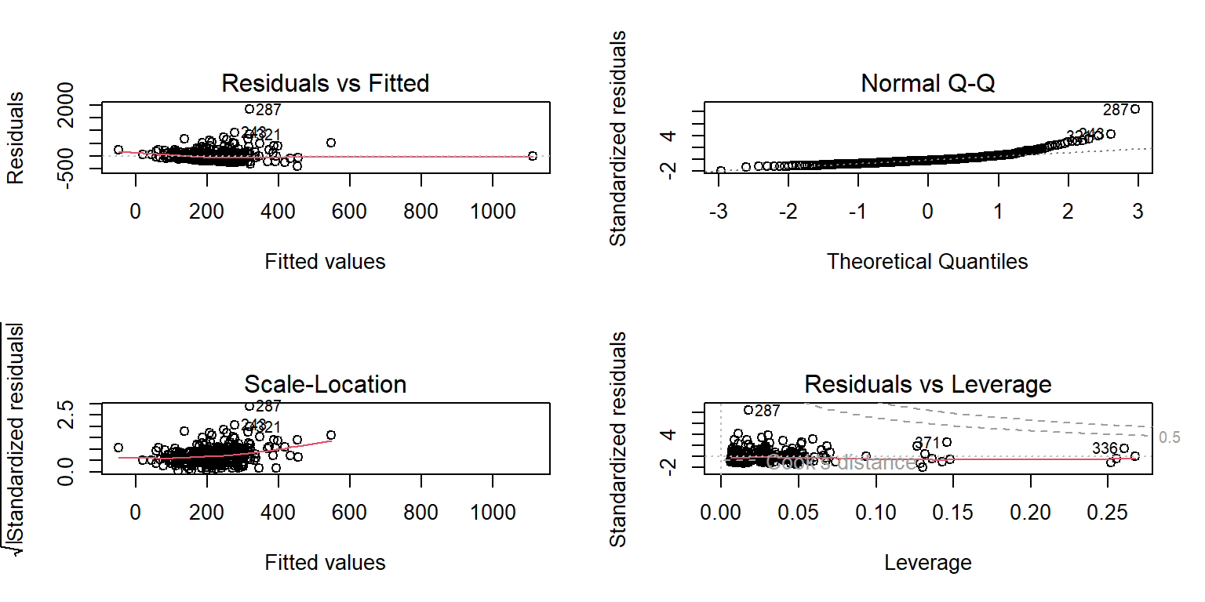
Question 1: Can a tennis player’s rank predicted by his attributes?
III. Results
Figure 4: Linearity Assumptions and Model Verification
Gray Team (Nick Carroll, Jiaxin Ying, Emmanuel Ruhamyankaka, Song Young Oh)

Slide 11
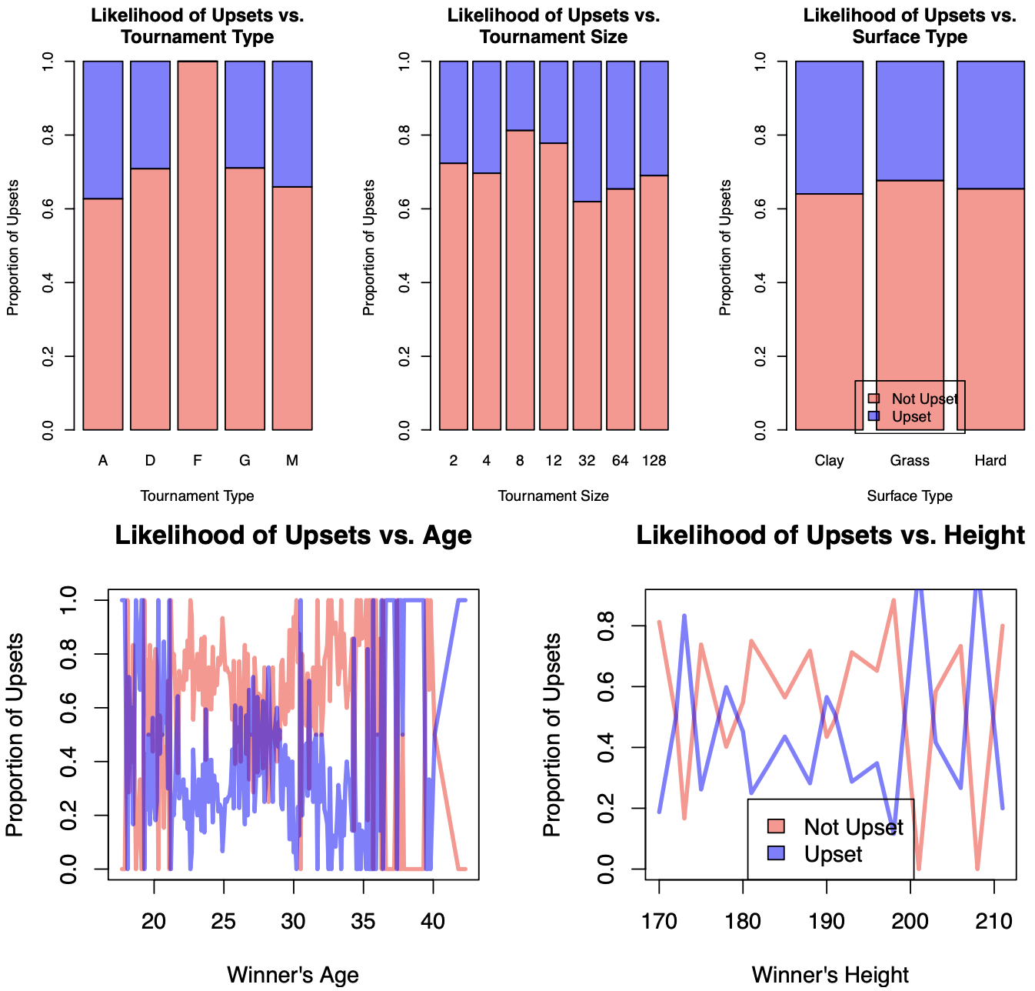
Question 2: Which factors have the greatest impact on an upset?
III. Results
Figure 5: EDA plots for Question 2
Gray Team (Nick Carroll, Jiaxin Ying, Emmanuel Ruhamyankaka, Song Young Oh)

Slide 12
Question 2: Which factors have the greatest impact on an upset?
III. Results
Table 2: Logistic Regression Model Results
Term | Odds Est. | Log Odds Est. | Statistic | P-value
Height (Lower Rank) | 0.866 | -0.1437 | -1.1285 | 0.2591
Age (Lower Rank) | 1.524 | 0.4216 | 2.2236 | 0.0262
Tournament: Standard | 1 | ------- | ------- | -------
Tournament: Finals | 0.139 | -1.9744 | -0.0008 | 0.9993
Tournament: Grand Slam | 0.006 | -5.1621 | -0.8645 | 0.3873
Tournament: Master’s | 0.00015 | -8.8214 | -2.2213 | 0.0263
Tournament Size | 1.065 | 0.0633 | 1.2796 | 0.2007
Match Surface: Hard |  | ------- | ------- | -------
Match Surface: Clay | 11.837 | 2.4712 | 1.2379 | 0.2158
Match Surface: Grass | 0.559 | -0.5811 | -0.1283 | 0.8979
Tournament Date | 1.002 | 0.0024 | 0.8496 | 0.3956
Tournament Seed (Lower Rank) | 2.056 | 0.7209 | 2.7221 | 0.0065
Hand: Right (Lower Rank) | 1 | ------- | ------- | -------
Hand: Left (Lower Rank) | 0.080 | -2.5274 | -1.1016 | 0.2706
Hand: Right (Higher Rank) | 1 | ------- | ------- | -------
Hand: Right (Higher Rank) | 0.220 | -1.5162 | 0.5115 | 0.6090
Height (Higher Rank) | 1.184 | 0.1687 | 1.3920 | 0.1639
Age (Higher Rank) | 1.075 | 0.0722 | 0.5482 | 0.5836
Round: of 64 | 1 | ------- | ------- | -------
Round: Quarter Final | 190.281 | 5.2485 | 1.8691 | 0.0616
Round: of 16 | 51.403 | 3.9397 | 1.4485 | 0.1475
Round: of 32 | 29.415 | 3.3815 | 0.8164 | 0.4143
Round: Round Robin | 0.715 | -0.3350 | -0.0425 | 0.9661
Round: Semi-Final | 1903.977 | 7.5517 | 2.1583 | 0.0309
Rank (Lower Rank) | 1.232 | 0.2089 | 2.5872 | 0.0097
Significant Predictors:
1) Master’s Tournament,
2) Grass Surface,
3) Age (Lower Rank)
95% Accuracy
Table 3: Confusion Matrix
 | FALSE | TRUE
FALSE | 98 | 4
TRUE | 3 | 42
Gray Team (Nick Carroll, Jiaxin Ying, Emmanuel Ruhamyankaka, Song Young Oh)

Slide 13
Key Takeaways
IV. Conclusion
Conclusion
The variables from our data are effective
to understand the factors that impact an upset.
1
Project
Multiple Linear Regression
Tournament type, match surface, and player’s age
are all strong indicators for predicting the likelihood of upsets.
2
Multiple Logistic Regression
Statistical Analysis
However, the variables are insufficient
to predict a player’s average rank for a season
based on their attributes.
3
2021 ATP tennis dataset
There are substantial variabilities in the player’s rank,
it cannot be only explained by the player’s attributes.
4
Gray Team (Nick Carroll, Jiaxin Ying, Emmanuel Ruhamyankaka, Song Young Oh)

Slide 14

Limitations & Future Directions
IV. Conclusion
We did not consider two key points for predicting a player’s rank.
There may be underlying confounding variables that impact the likelihood of an upset.
Limitations
Research 1
1. The analysis is based on a player’s ‘average’ rank for the season.
– A season lasts several months and can have unexpected events such as injuries.
Can a tennis player’s rank be predicted by his attributes, specifically: height, age, nationality, and handedness?
Potential Factors of performance which are not captured in the data:
Serve speed
Lateral speed
reaction time
Future Research:
Exploring how a player's skills, psychological status, or recent performance impact the likelihood of an upset.
2. We only regressed ranks based on personal attributes.
– We did not consider the player’s skills which are more impactful than their height and age.
Research 2
1. While age can be an indicator of maturity, there might exist mental components to upsets.
– They are not accurately captured in the dataset.
Which factors have the greatest impact on the likelihood of
an upset?
2. The analysis indicates that players have little ability to impact their likelihood of upsets.
– Other internal factors of the player should also be taken into account.
Gray Team (Nick Carroll, Jiaxin Ying, Emmanuel Ruhamyankaka, Song Young Oh)

